Slide 1
Root
Account
accounts
Trip
trips
newEvents
Event
events

Slide 2
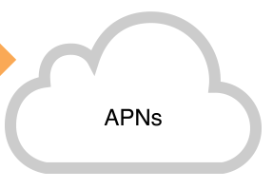


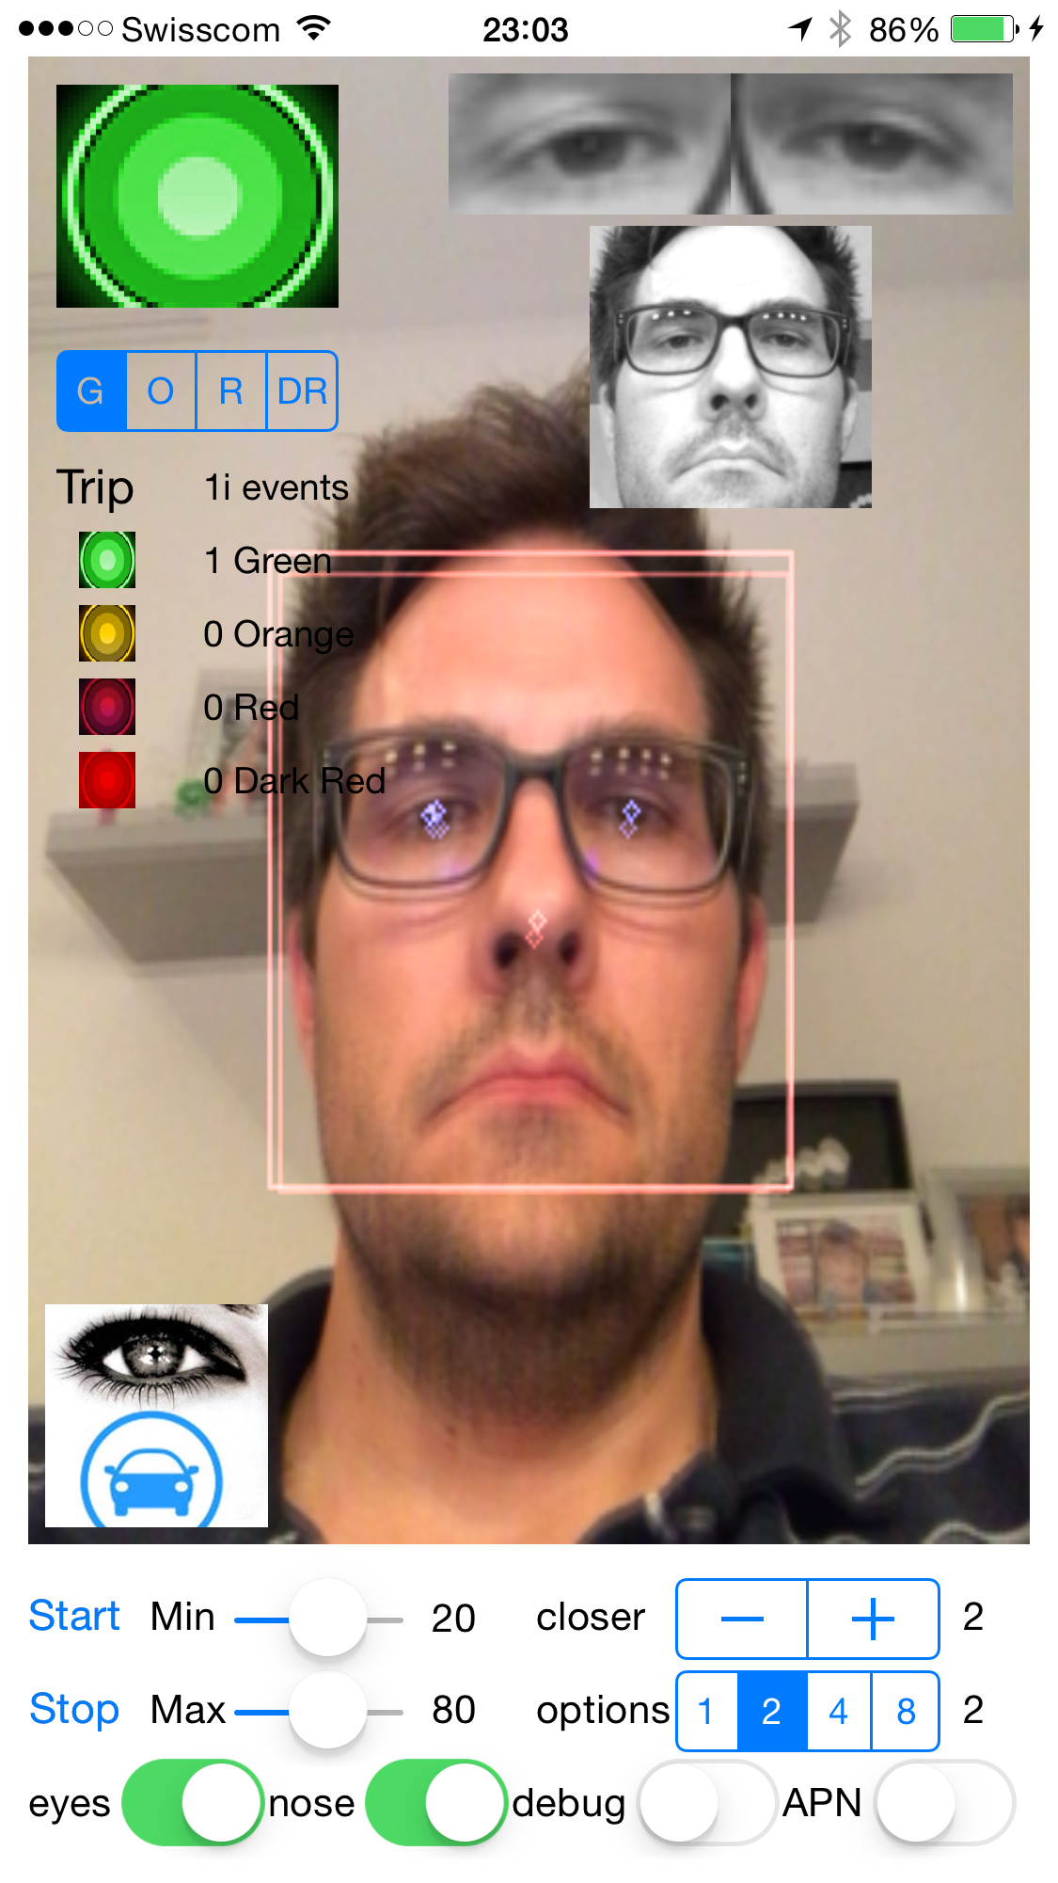
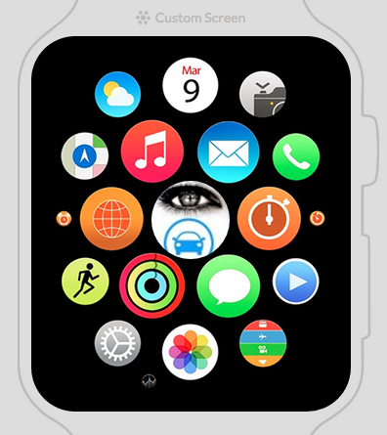
Eyes2drive Architecture
eyes2drive
Viewer
Car

